Slide 1
20201022 Milestone Architecture
Thingsboard Tenant 1
Message Queue
Zookeeper
Topic
“Thingsboard”
Message 5
Offset 5
Mark the “total offset” is 5
Thingsboard Tenant 2
First in first out
Broker id = 0
Message 4
Offset 4
Zookeeper
UAT Site VM
UAT Site VM
Message 3
Offset 3
PM2 process manager / supervisor
Python program as Kafka Consumer
Message 2
Offset 2
Mark the “current offset” is 1
Delay 2s
Message 1
Offset 1
Save as telemetry in UAT Site
Assemble the SMS request following the SMS gateway format (2 recipients per request)
Polling 1 message from Kafka topic based on the offset record in Zookeeper
Send simulated SMS request via HTTPS
Message
Provide current offset record

Slide 2
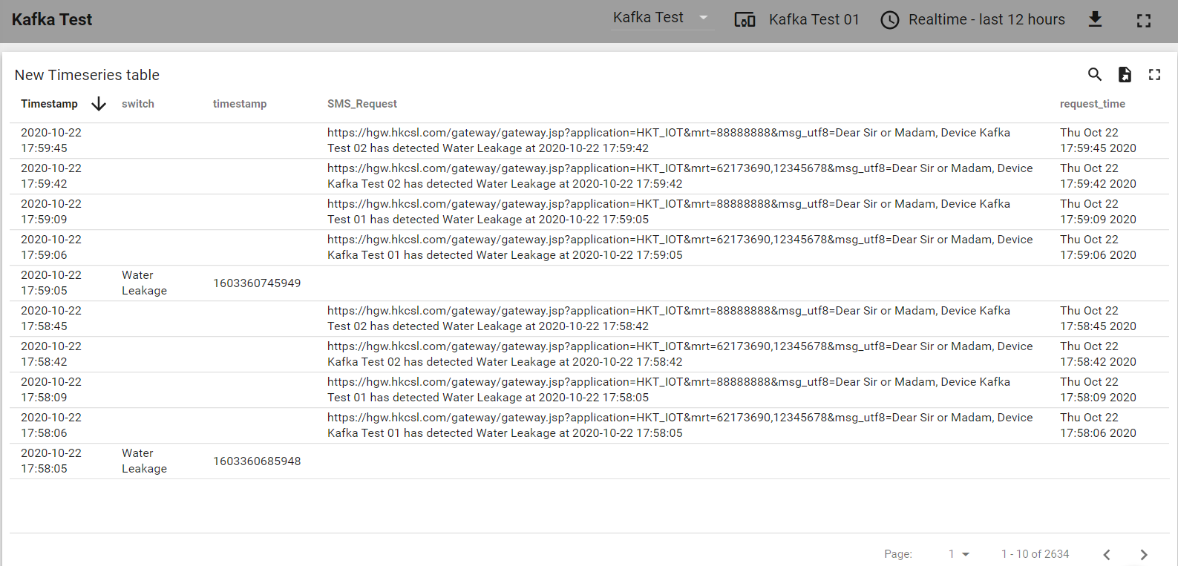
20201022 Milestone

